Slide 1
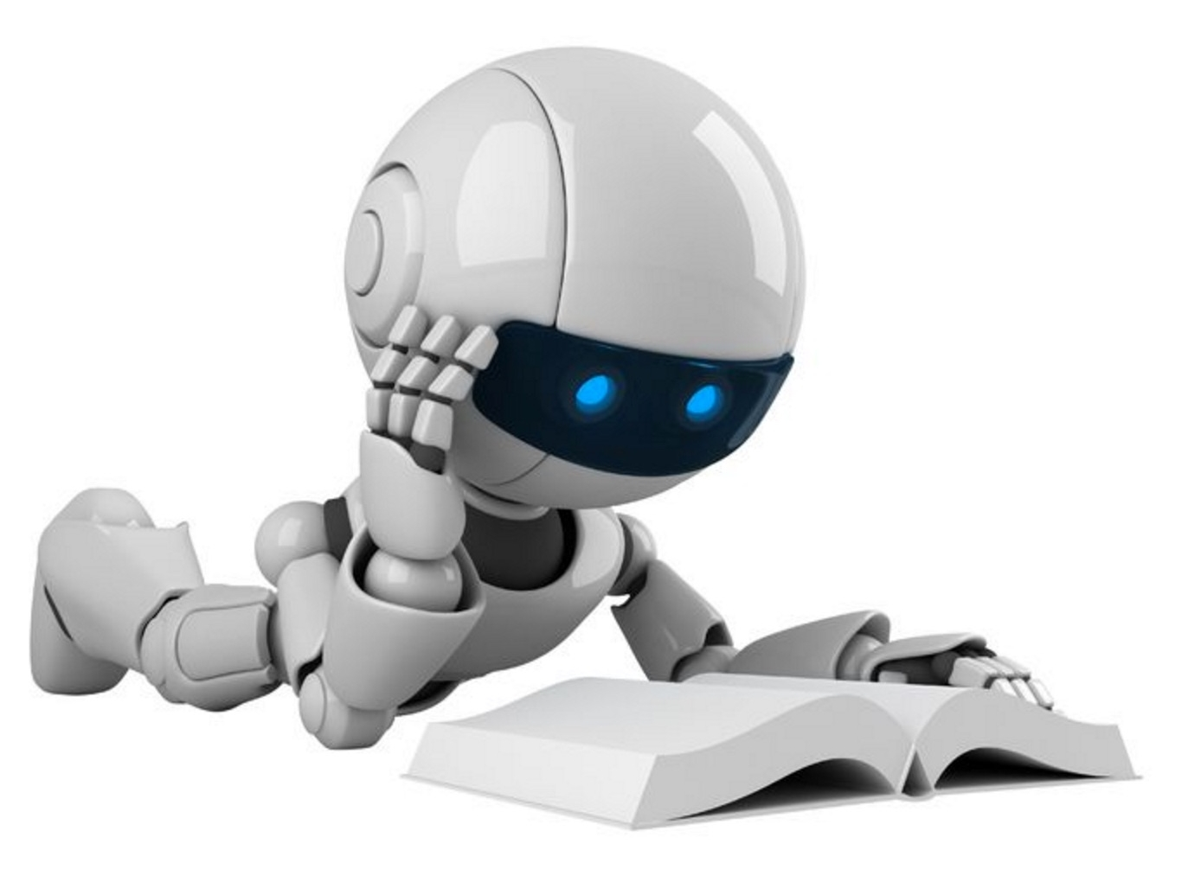
g
AI:
The Good,
The Bad, & The Impact on
Society
Scott Mauvais
scott@mauvais.com
July 22, 2025
www.mauvais.com/talks

Slide 2

Agenda
The Bad
There is inherent bias in the data that underpins AI
The Good
AI provides a path for addressing extremely difficult problems
The Impact
What does this mean for jobs, for art,
for society

Slide 3



Agenda
The Bad
There is inherent bias in the data that underpins AI
The Good
AI provides a path for addressing extremely difficult problems
The Impact
What does this mean for jobs, for art,
for society

Slide 4
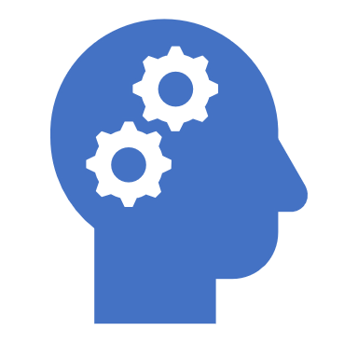
Data voids create bias

Slide 5
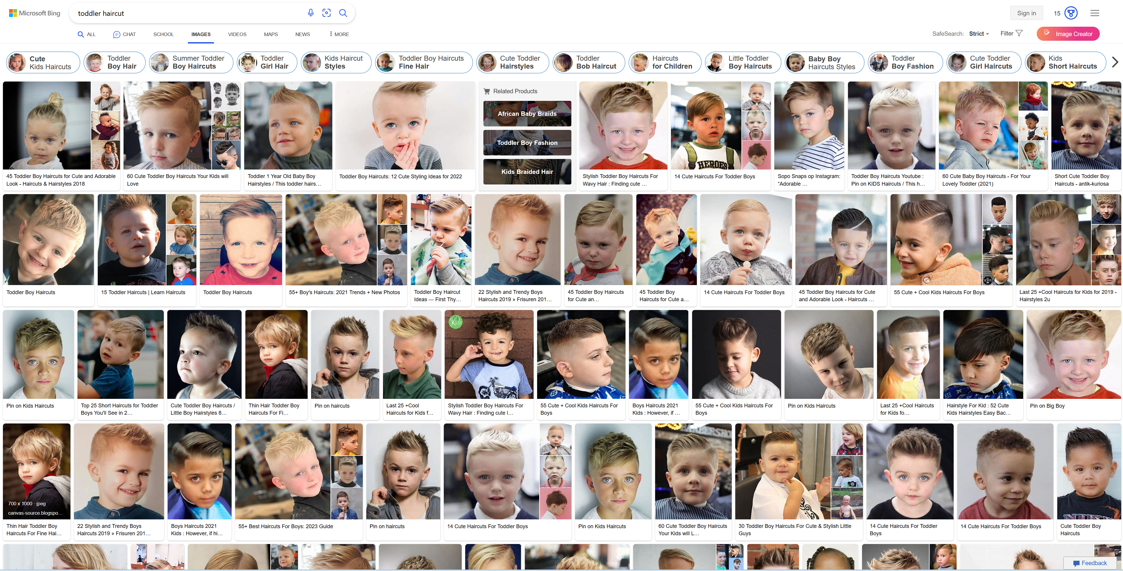

Slide 6
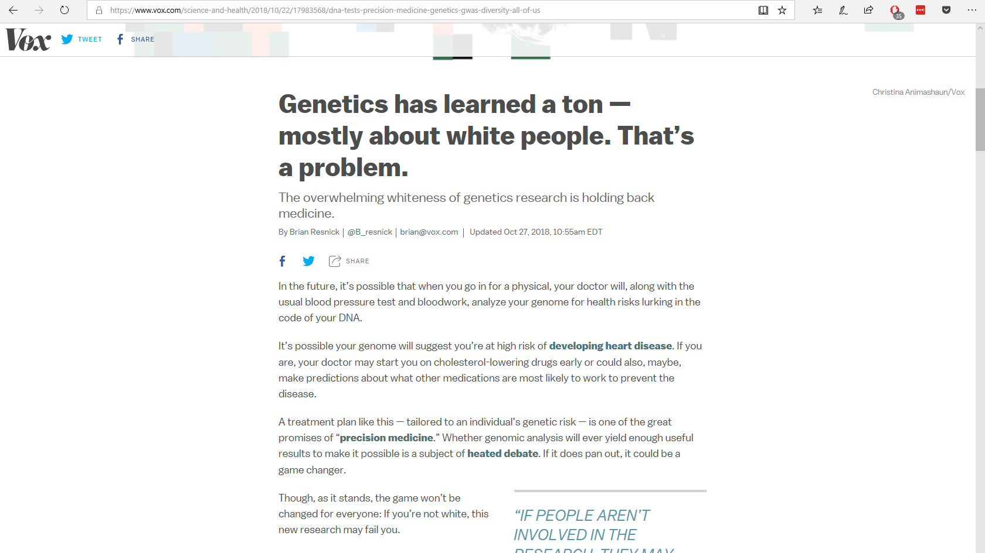

Slide 7


Slide 8
Reality is biased

Slide 9
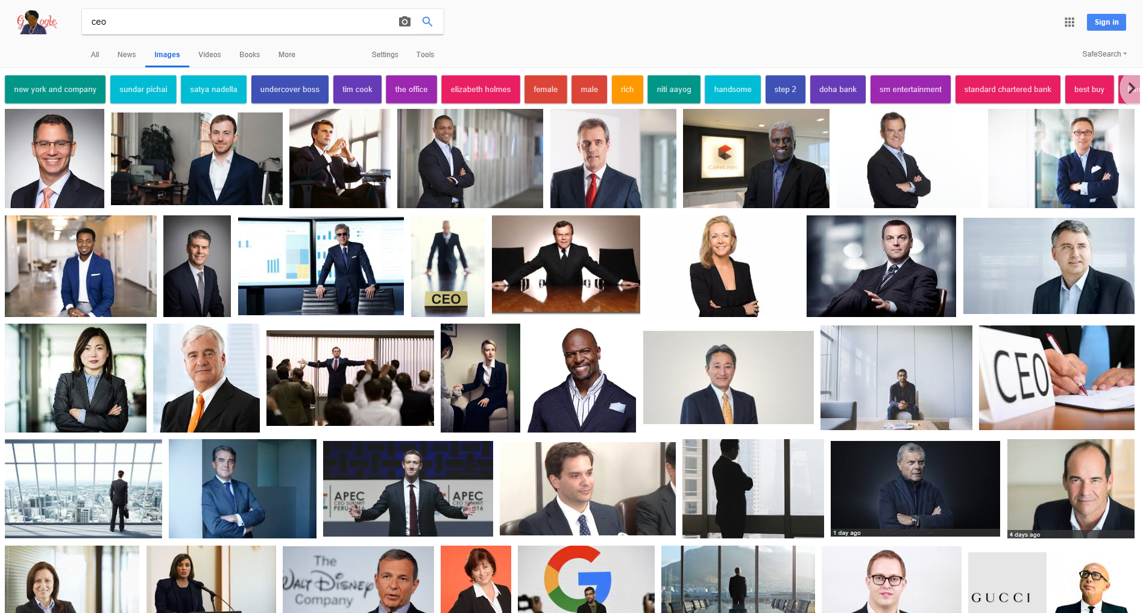

Slide 10
Percentage of Fortune 500 CEOs

Slide 11
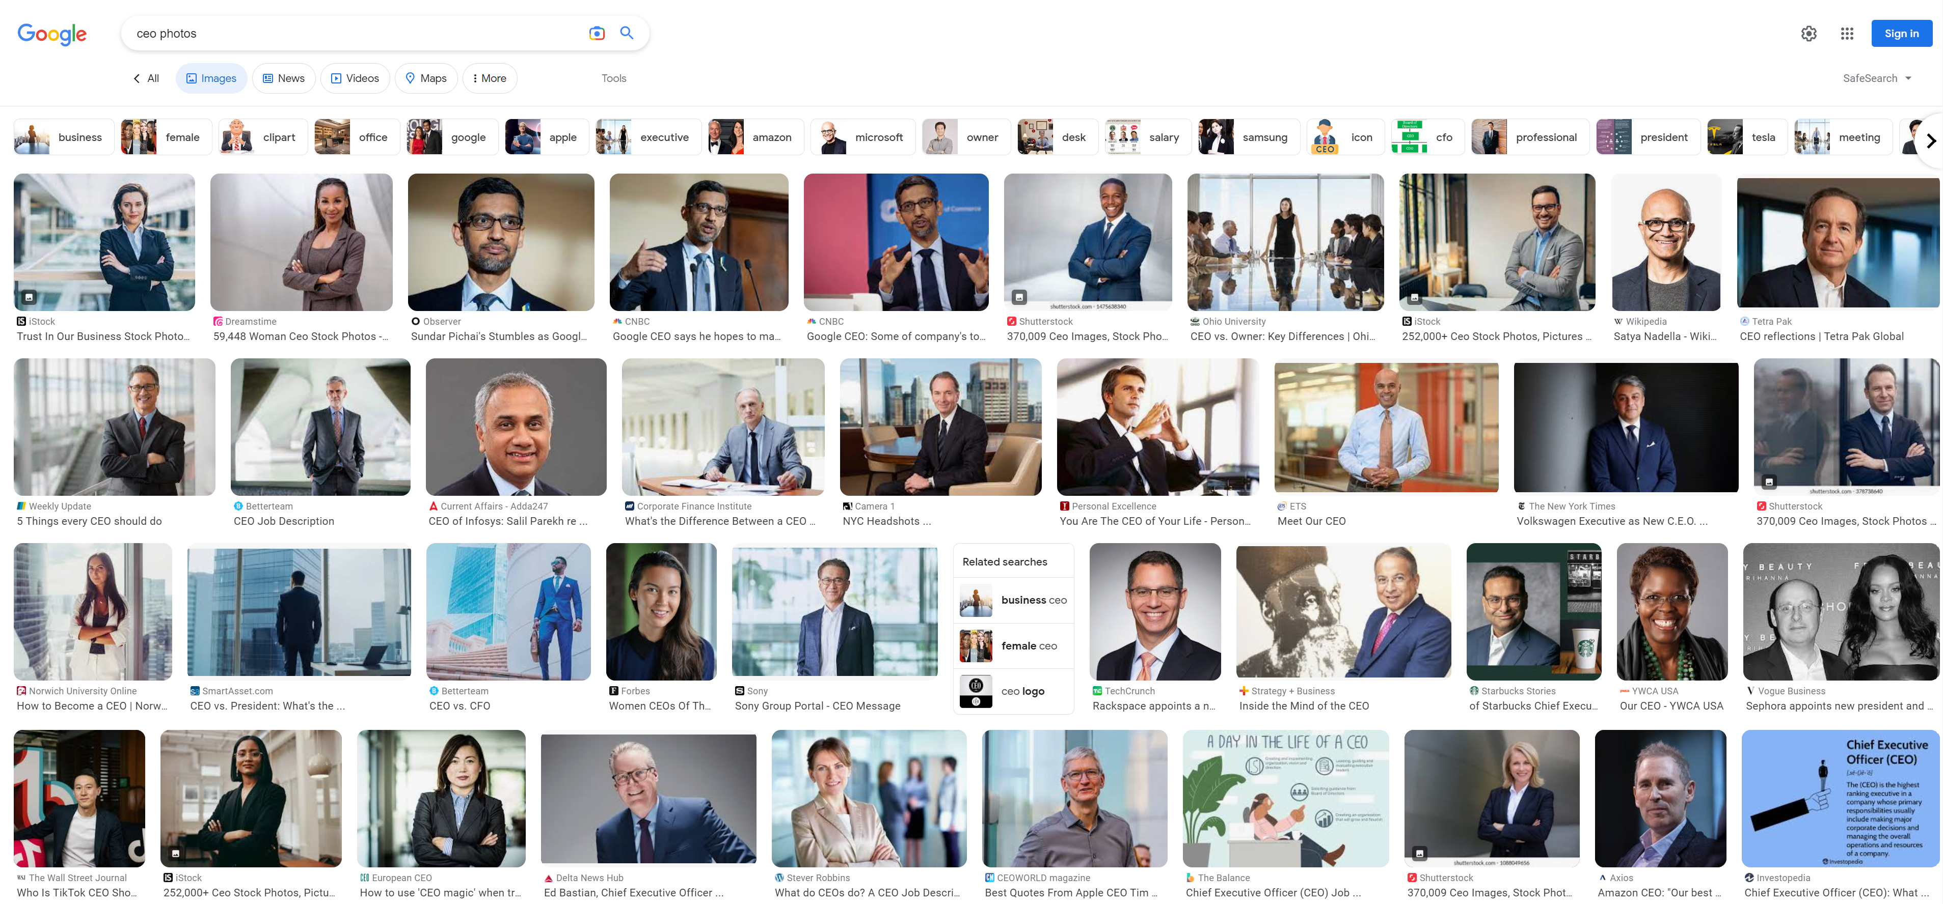
Search Engines Curating Results (2023)

Slide 12
Search Engines Curating Results (2023)

Slide 13
More than just the data is biased

Slide 14
The is problem us
We are biased

Slide 15

We are AI’s study-buddy and we are teaching all our misogyny and hatred
—Amy Webb

Slide 16

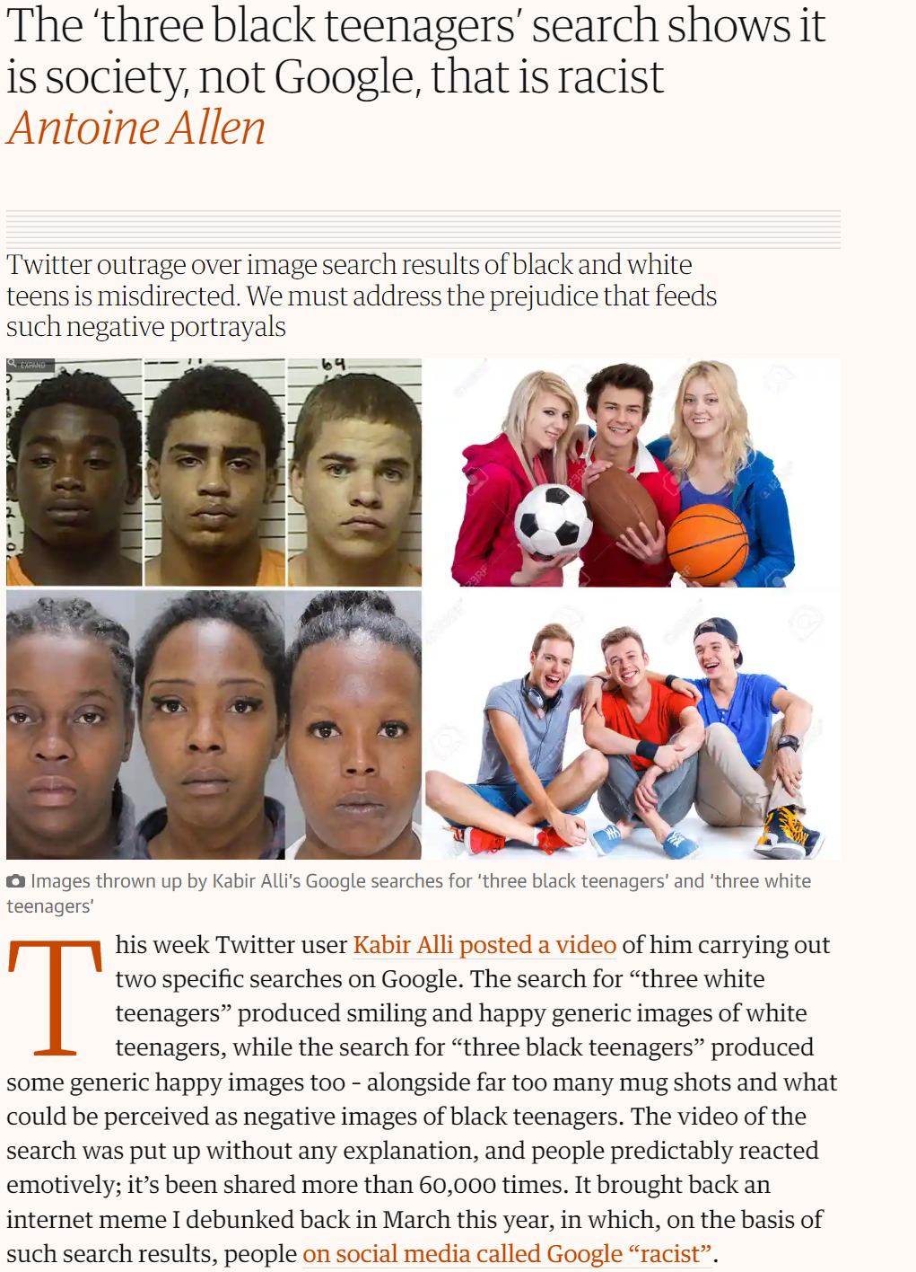

Slide 17
Bias in AI is fixable
(I’m not so sure about human bias)

Slide 18
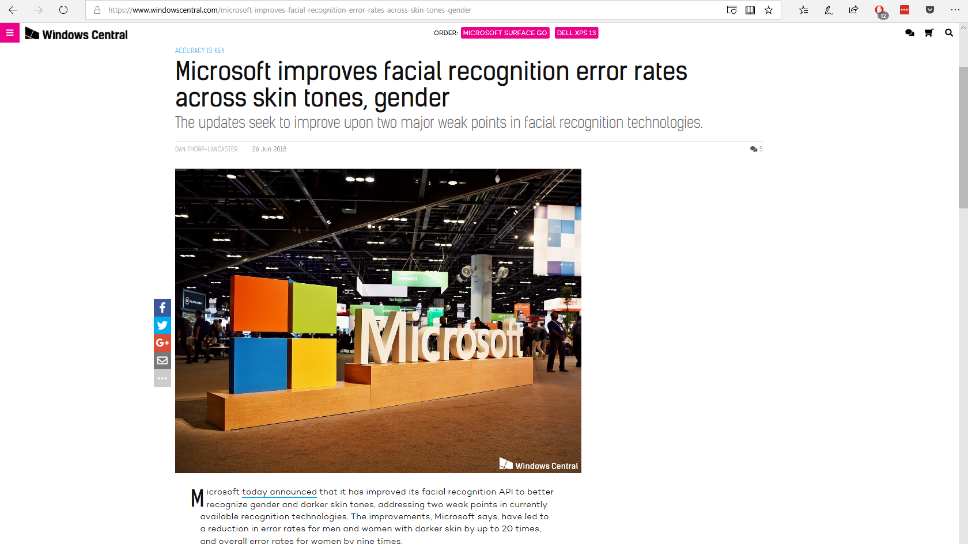

Slide 19
Agenda
The Bad
There is inherent bias in the data that underpins AI
The Good
AI provides a path for addressing extremely difficult problems
The Impact
What does this mean for jobs, for art,
for society

Slide 20
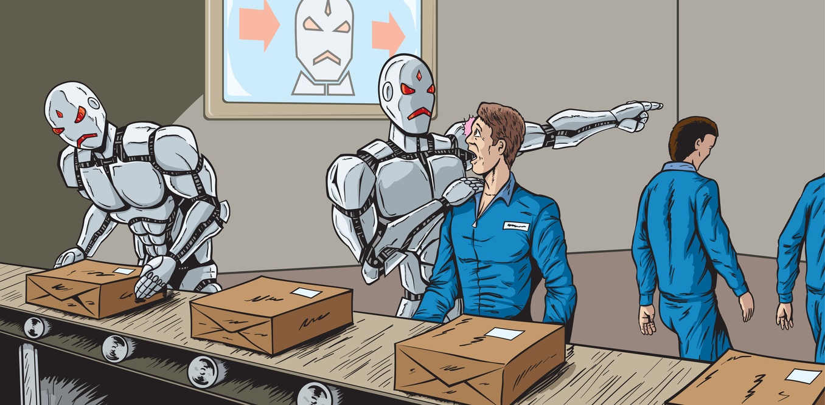

Slide 21
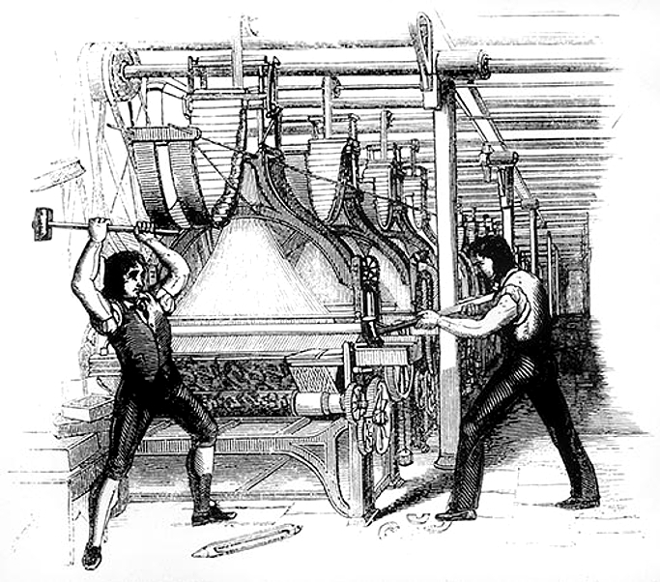

Slide 22
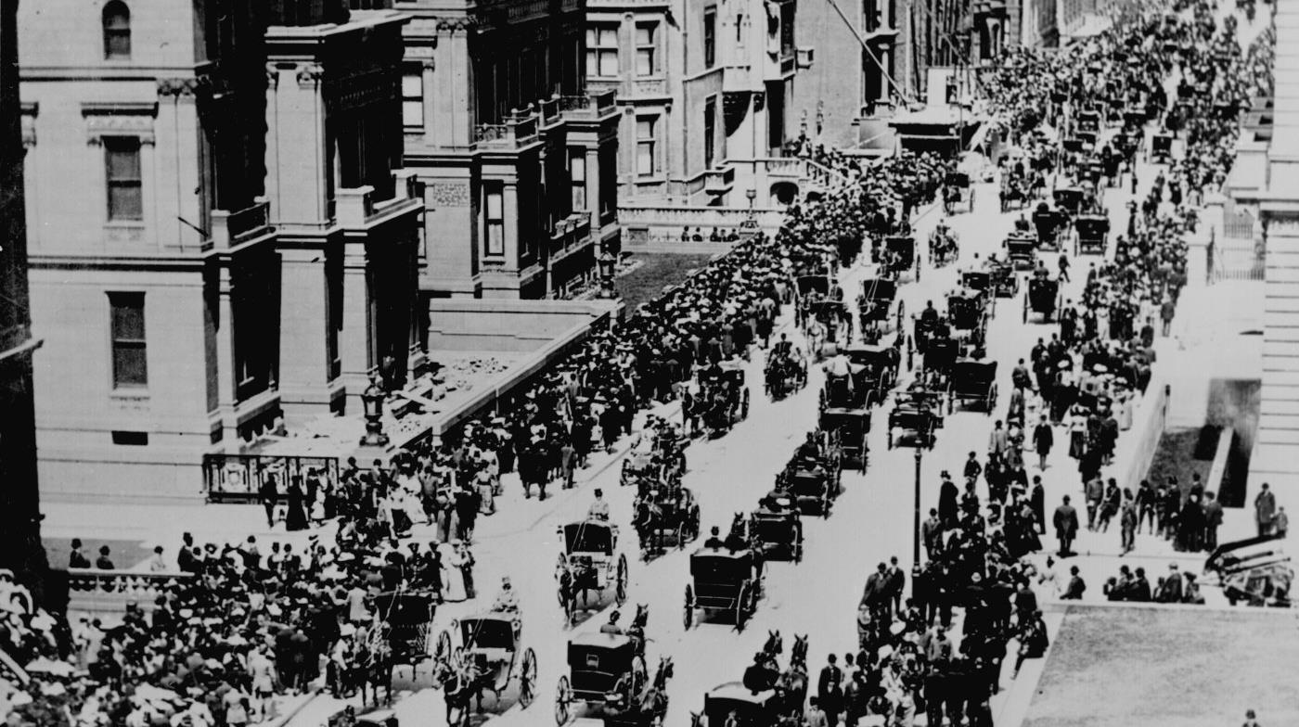

Slide 23
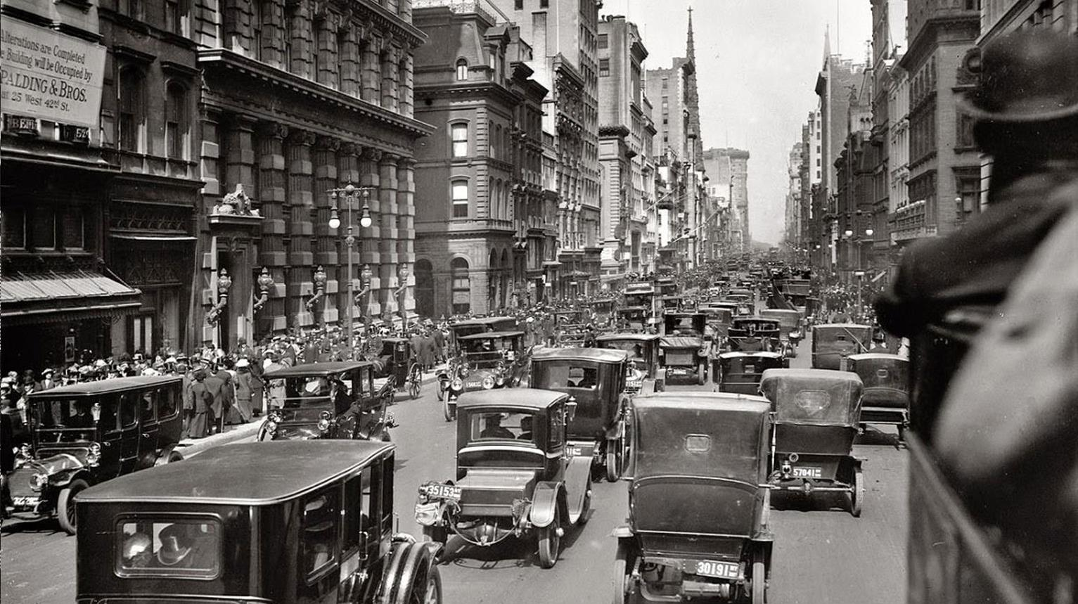

Slide 24
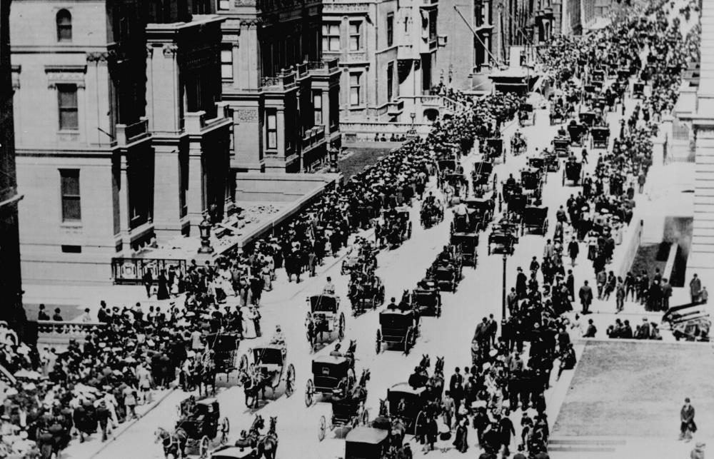
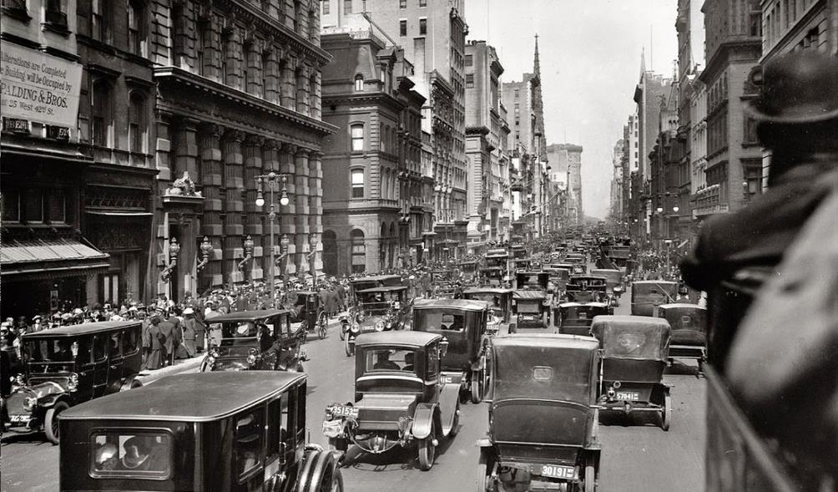

Slide 25
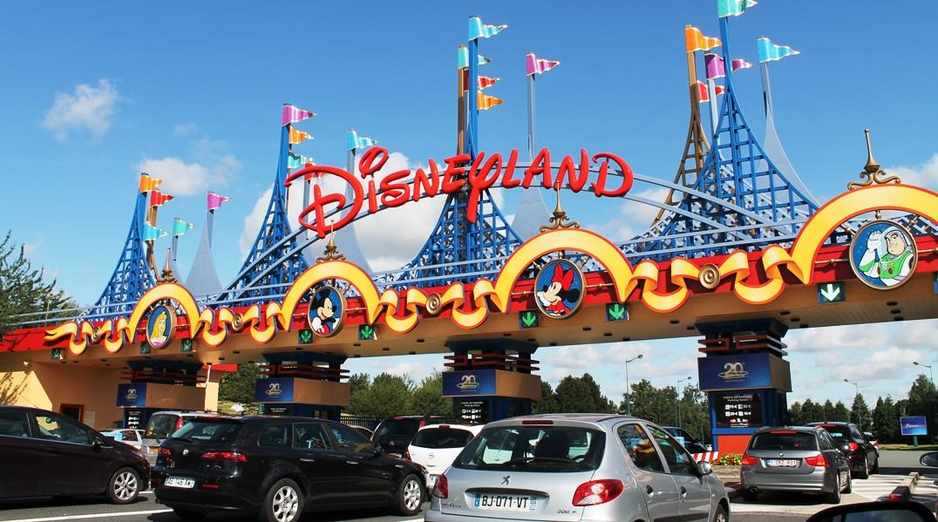

Slide 26
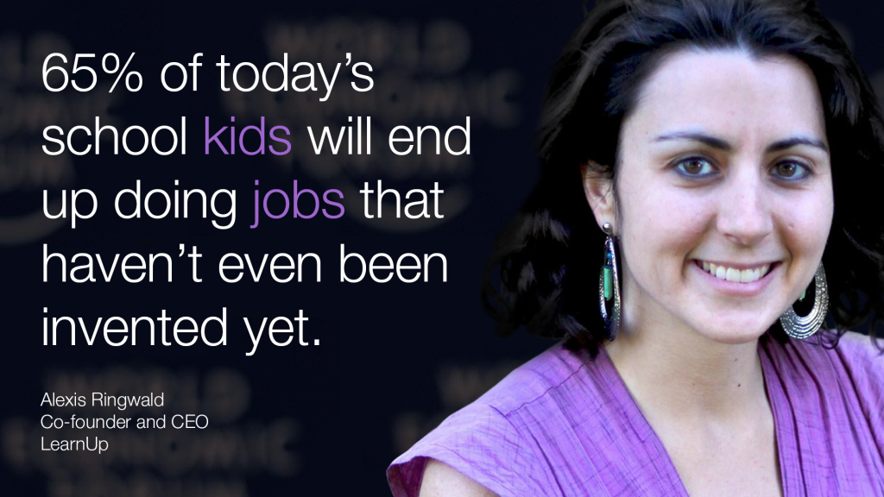

Slide 27
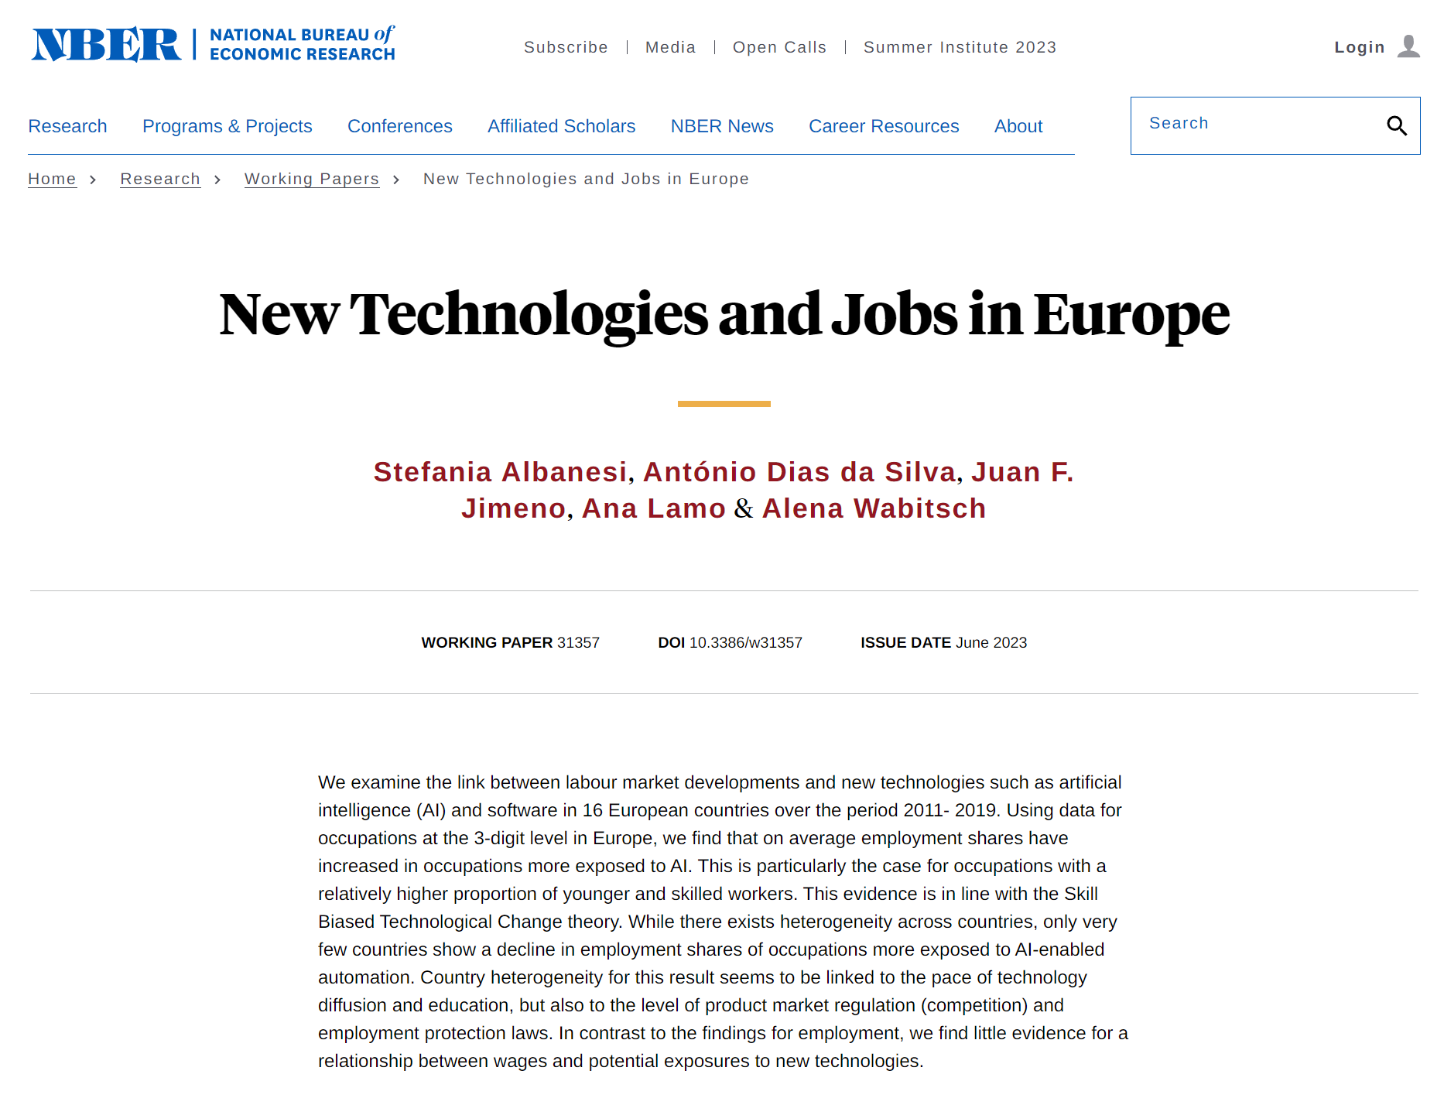

Slide 28
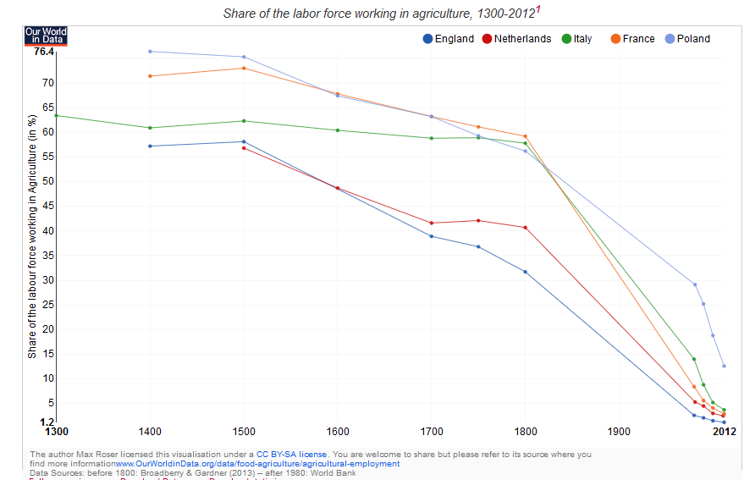

Slide 29
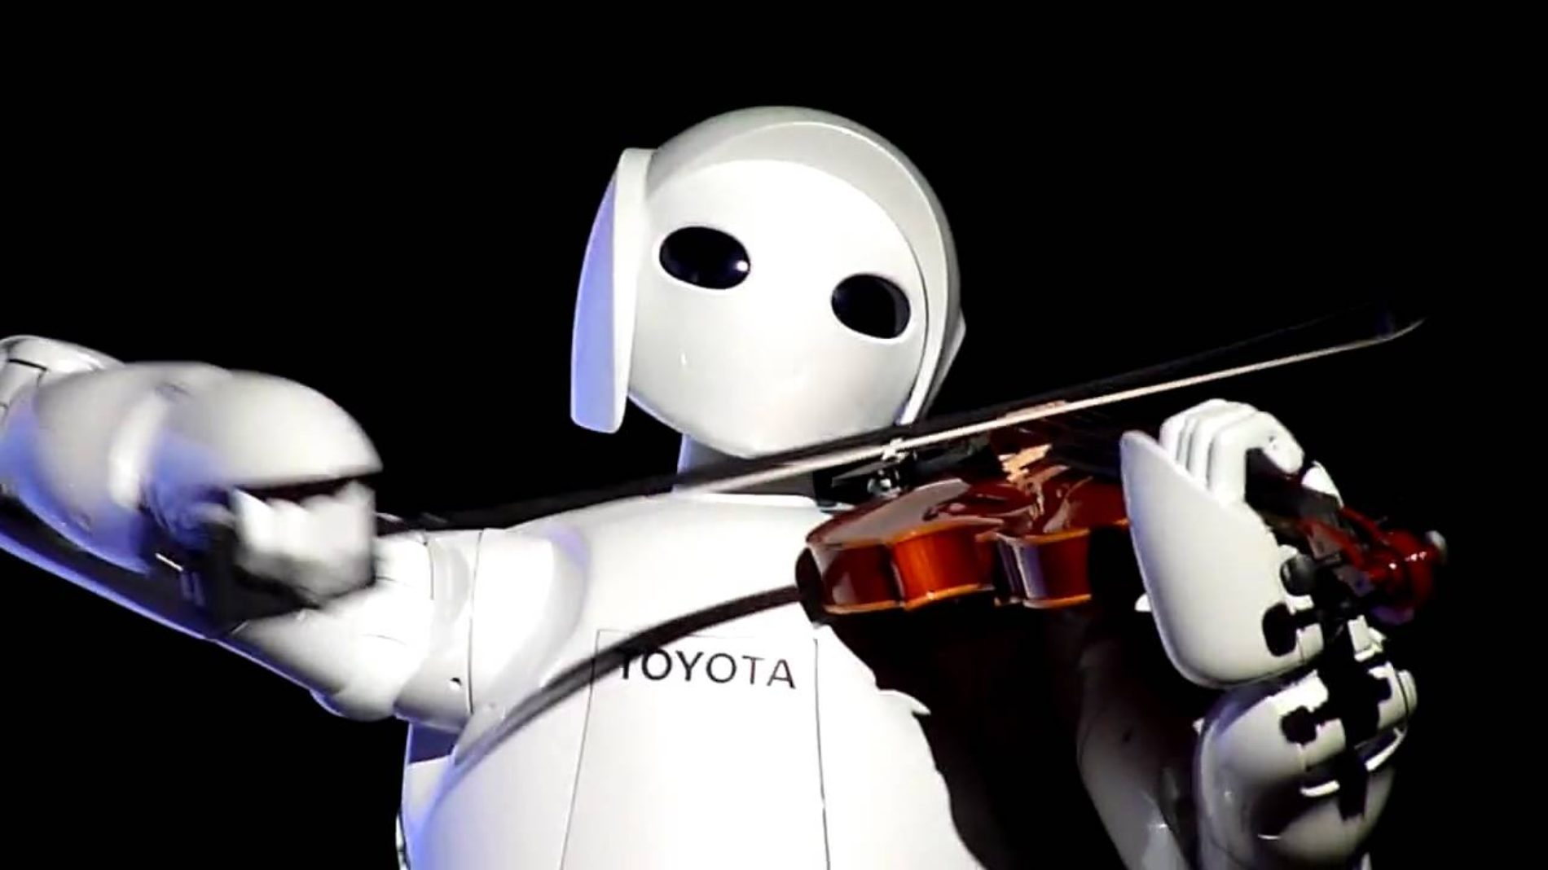

Slide 30
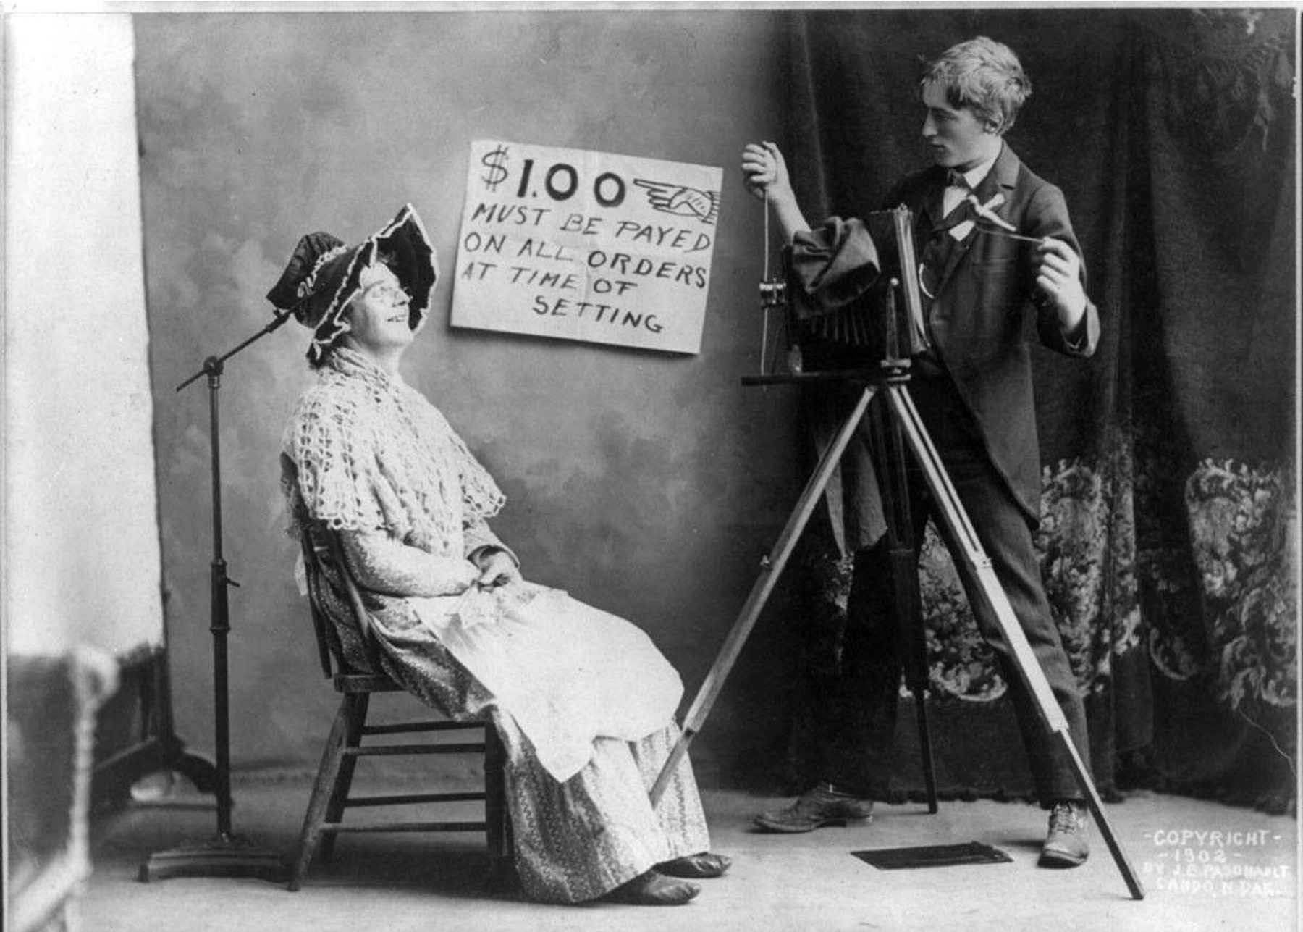

Slide 31
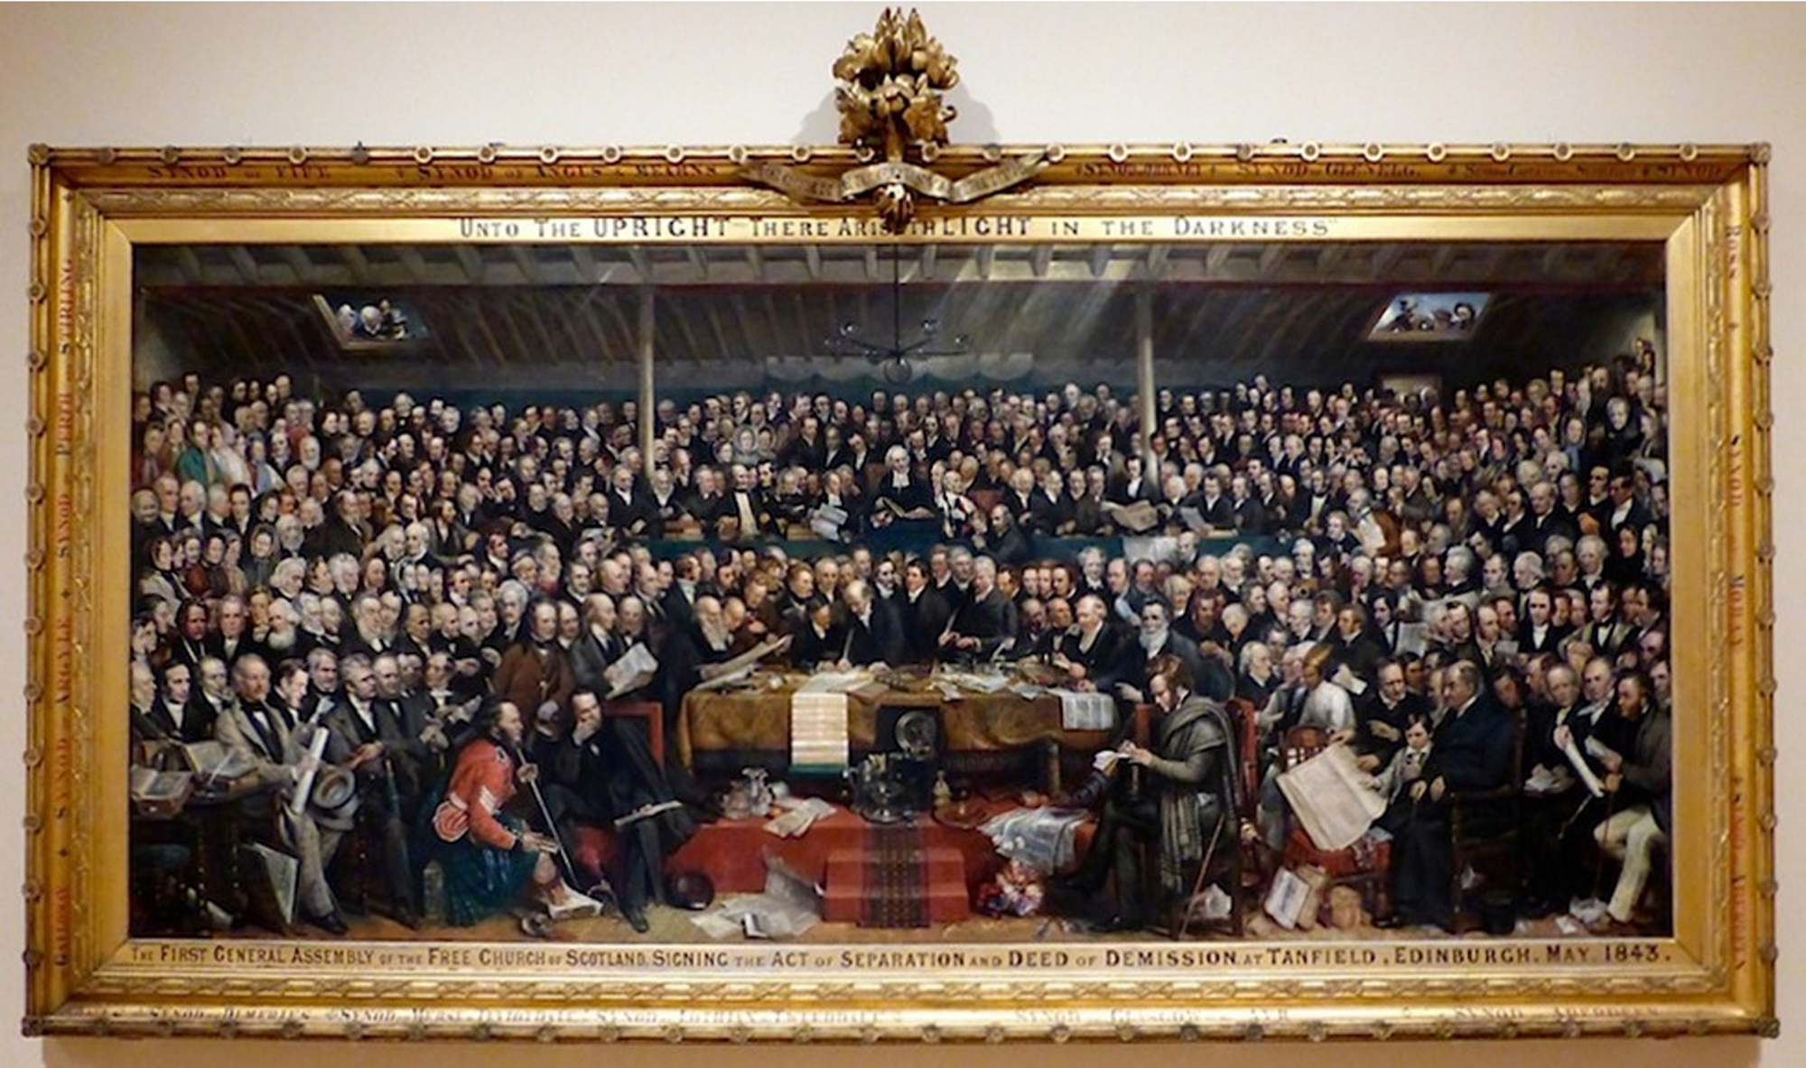

Slide 32
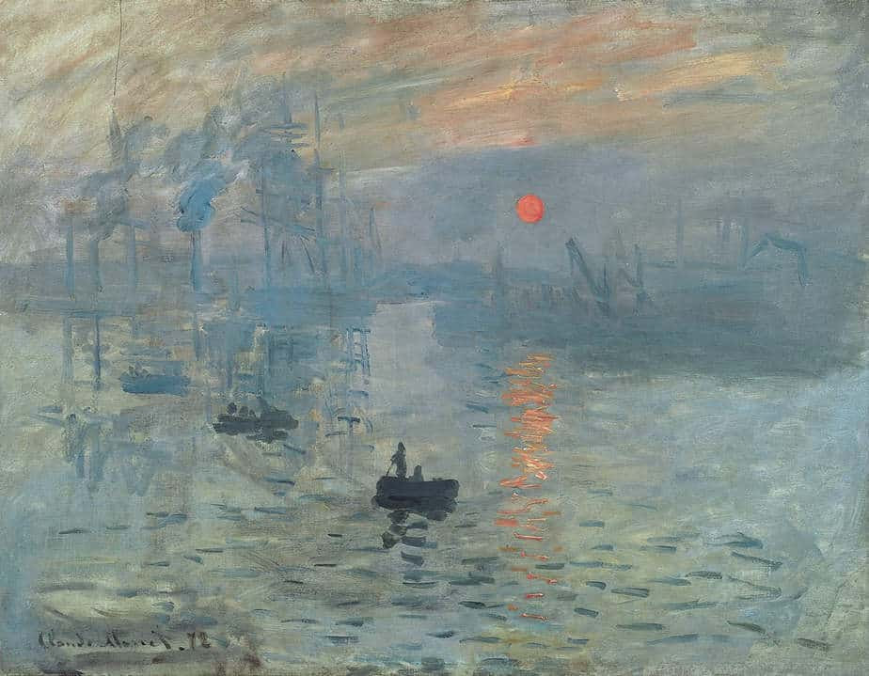

Slide 33
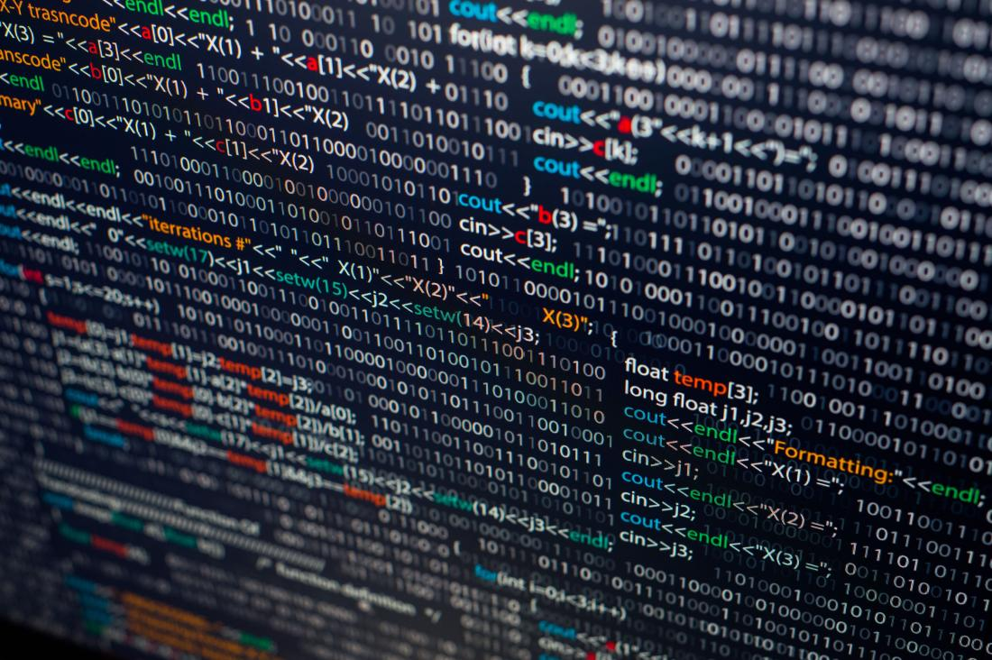

Slide 34
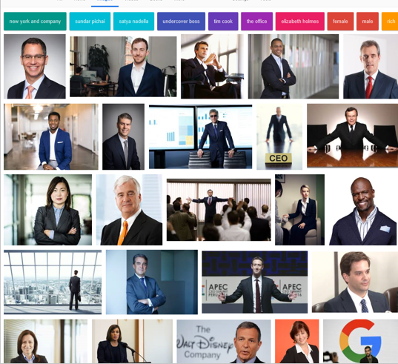
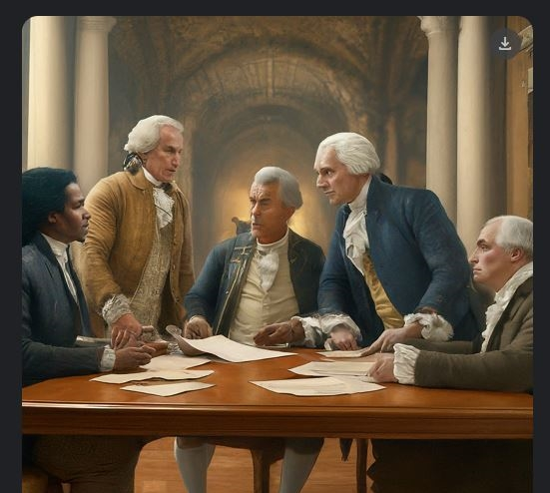
Which is worse?

Slide 35
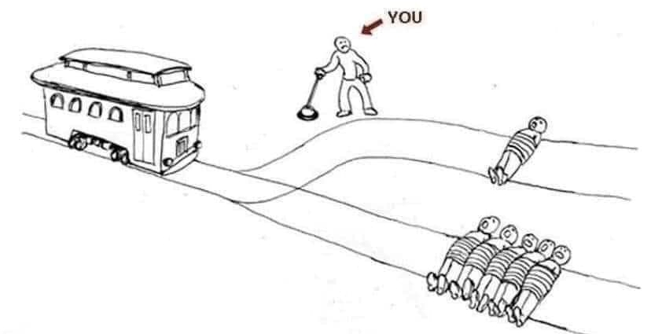

Slide 36
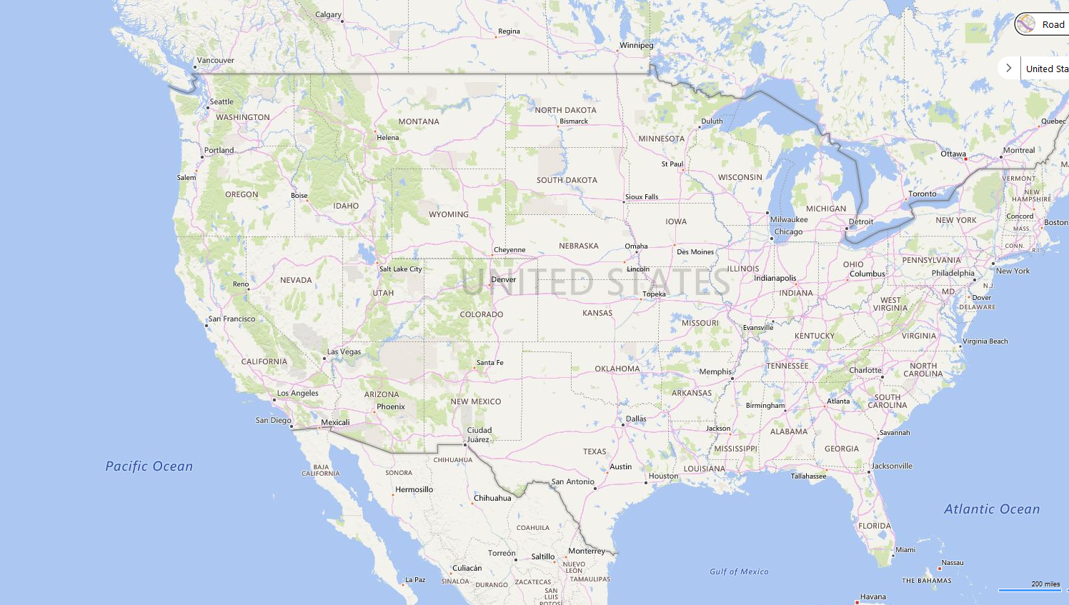






Slide 37
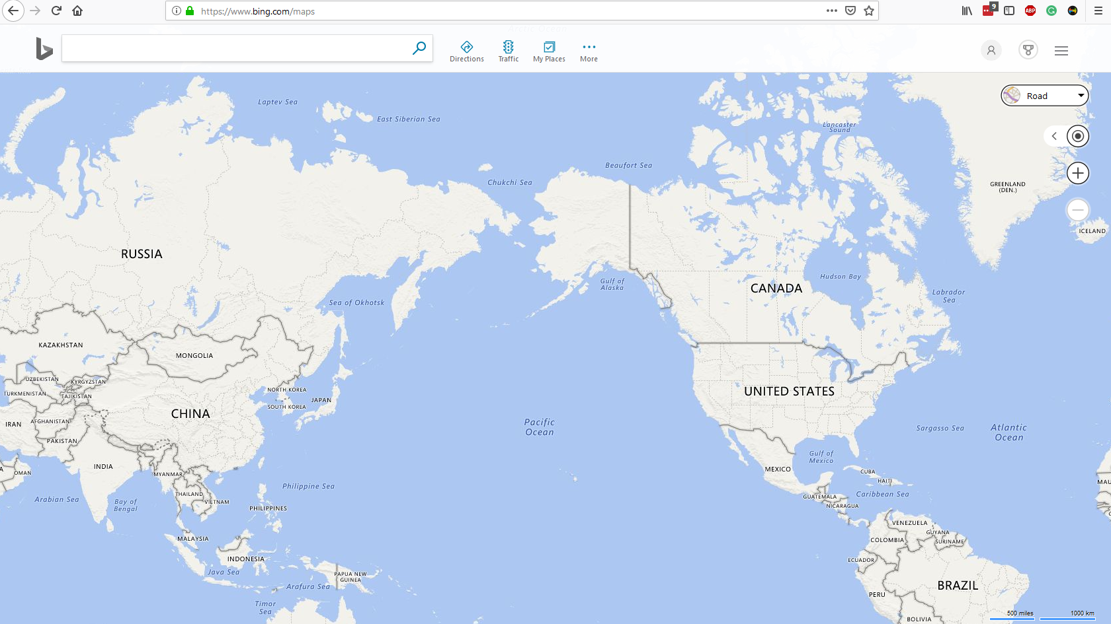

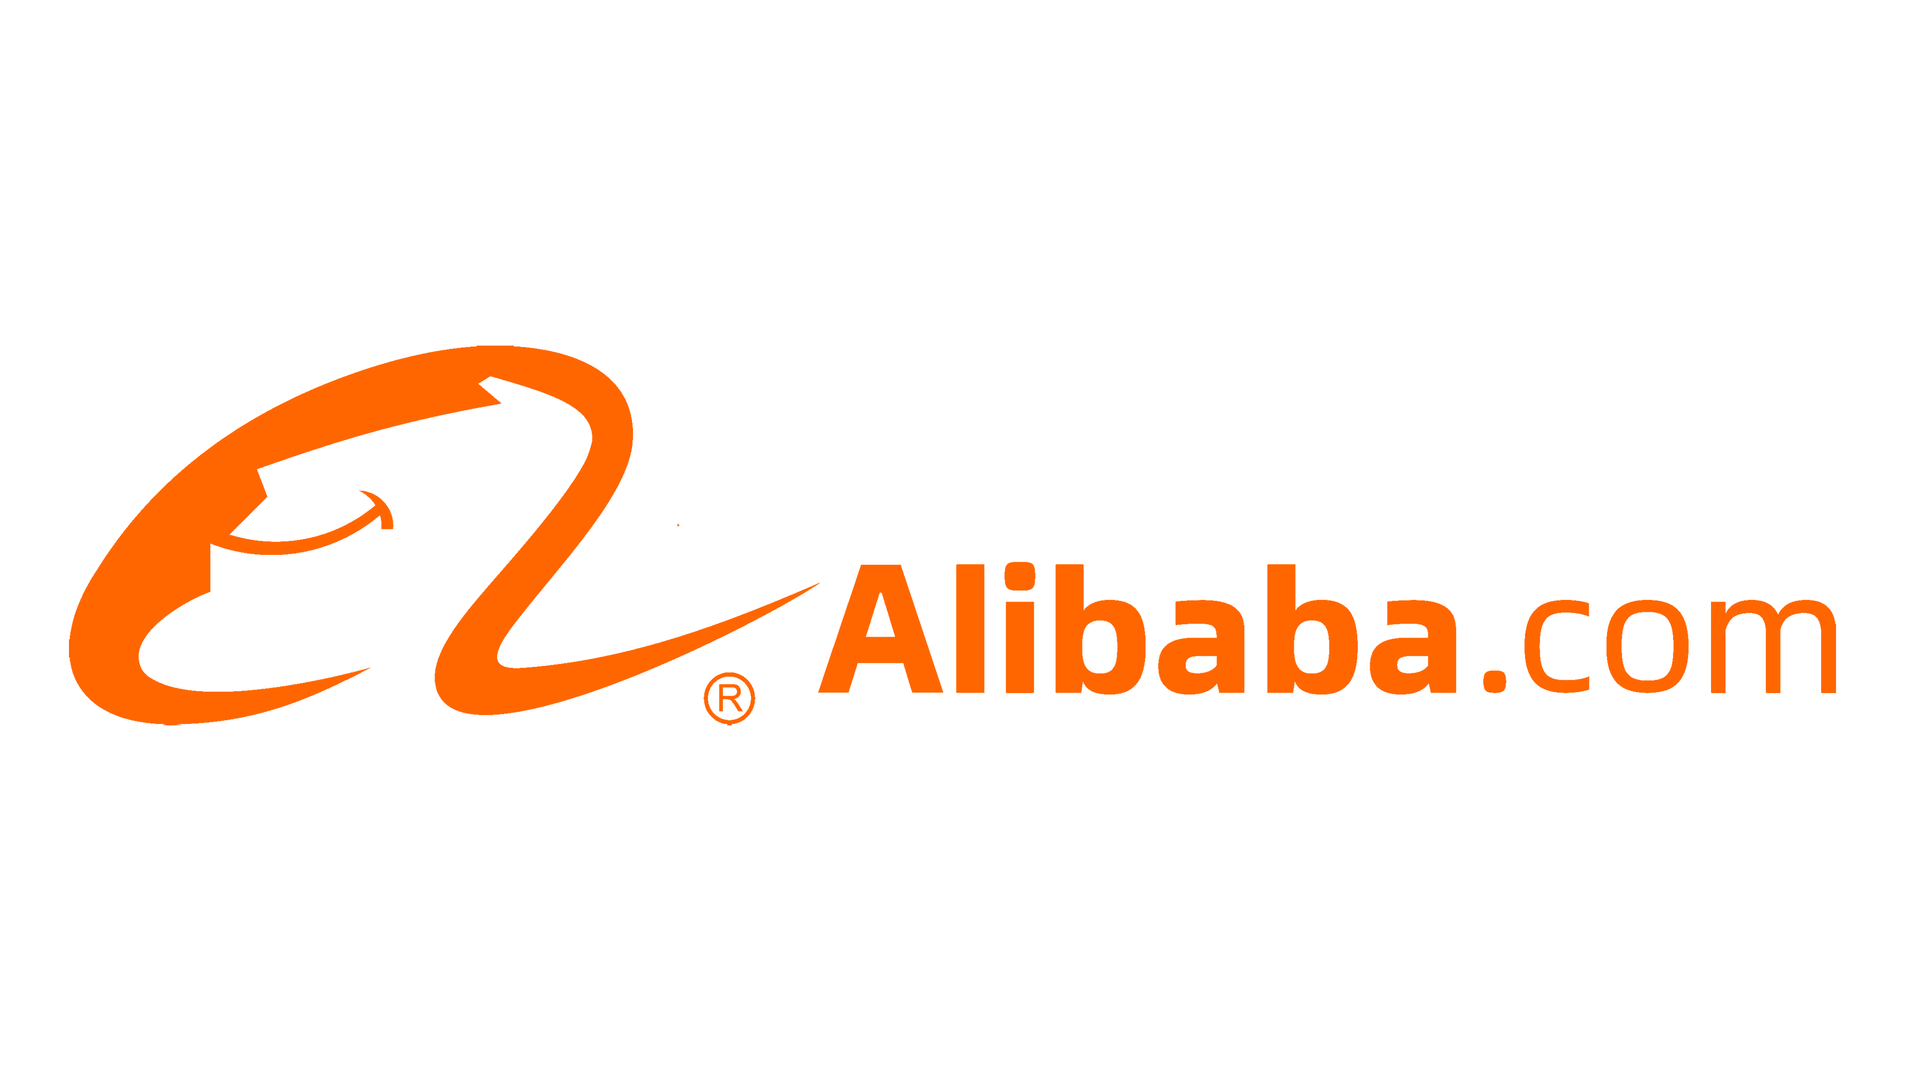


Slide 38
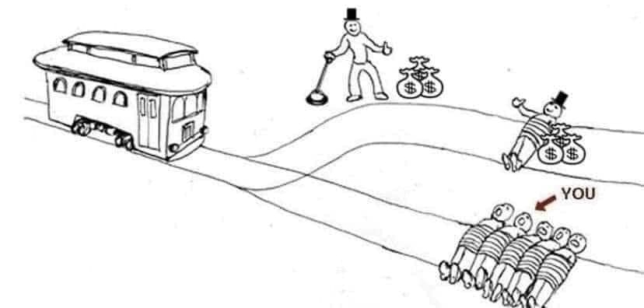

Slide 39
San Francisco 2023
AI Robotics Youth Program
g
AI:
The Good,
The Bad, & The Impact on
Society
Scott Mauvais
scott@mauvais.com
www.mauvais.com/talks

