Slide 1
Responsible AI:
Turning Theory into Practice
Scott Mauvais
scott@mauvais.com

Slide 2
Agenda
Corporate Social Impact Framework
Microsoft Path to Responsible AI Initiatives
AI for Good Examples
Discussion

Slide 3
Business Rational for Social Impact Investments
Attract and retain talent
Proactive
Help customer buy and use your products
Appeal to priority demographics
Reactive
Address unintended consequences of your product
Prepare for changes in business / regulatory climate

Slide 4
Business Rational for Social Impact Investments
Attract and retain talent
Proactive
Help customer buy and use your products
Appeal to priority demographics
Reactive
Address unintended consequences of your product
Prepare for changes in business / regulatory climate
Identify your target audience

Slide 5
Align Social Impact Priorities to Core Business
Why
Domain expertise
Sustainable funding
Consistent priorities
Authentic commitment
How
Convene for cross-sector collaborations
De-risk projects
Bring more than money

Slide 6
Microsoft’s Path to Responsible AI Initiatives
US Department of Justice antitrust case (1999)
Trustworthy Computing (2002)
Environmental sustainability initiatives (2009)
GDPR (2016)
AETHER - AI, Ethics and Effects in Engineering and Research (2016)
AI for Earth (2017)
Responsible AI Principles (2016/2018)
Facial recognition and policing (2018)
Responsible AI Standard (2019)

Slide 7
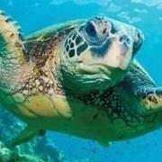
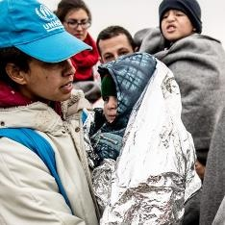
Using AI for Good
AI for Earth
Agriculture
Biodiversity
Climate Change
Water
AI for Accessibility
Education
Community
AI for Humanitarian Action
Disaster response
Refugees and Displaced people
Human rights
Needs of women and children
AI for Health
Quest for discovery
Global Health insights
Health equity
Employment
Home
COVID-19

Slide 8
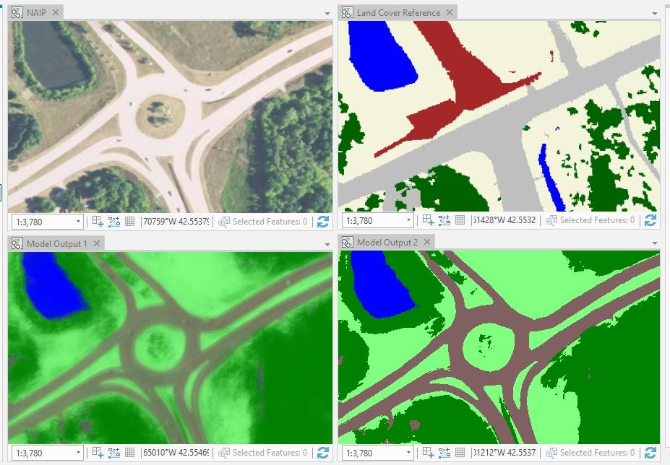
Land Cover Mapping
Existing land cover map
Created 7 years ago, out of date
Aerial photo
1m resolution, input data
Land classification model
Show mix of probabilities across land cover types
Land classification model
Classifying on the fly, and detects new roundabout
Oakland, Michigan

Slide 9
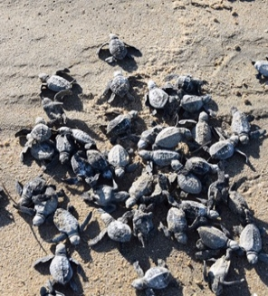
CASE STUDY: Australia, ANZ
Guidance for Field
Instructions Select regionally relevant case studies from appendix to add to the deck. Customize slide content for audience as needed. For latest case studies, visit Win Wire for complete list and description of S500 engagements.
CSIRO
Turtle conservation through AI
Partnered with Indigenous communities, nonprofits and private companies to reverse effects of predators on turtle populations.
AI-based solution is 90% accurate in analyzing tens of thousands of images every month.
The partnership has reduced the loss of turtle hatchlings from 100% to 30%.

Slide 10
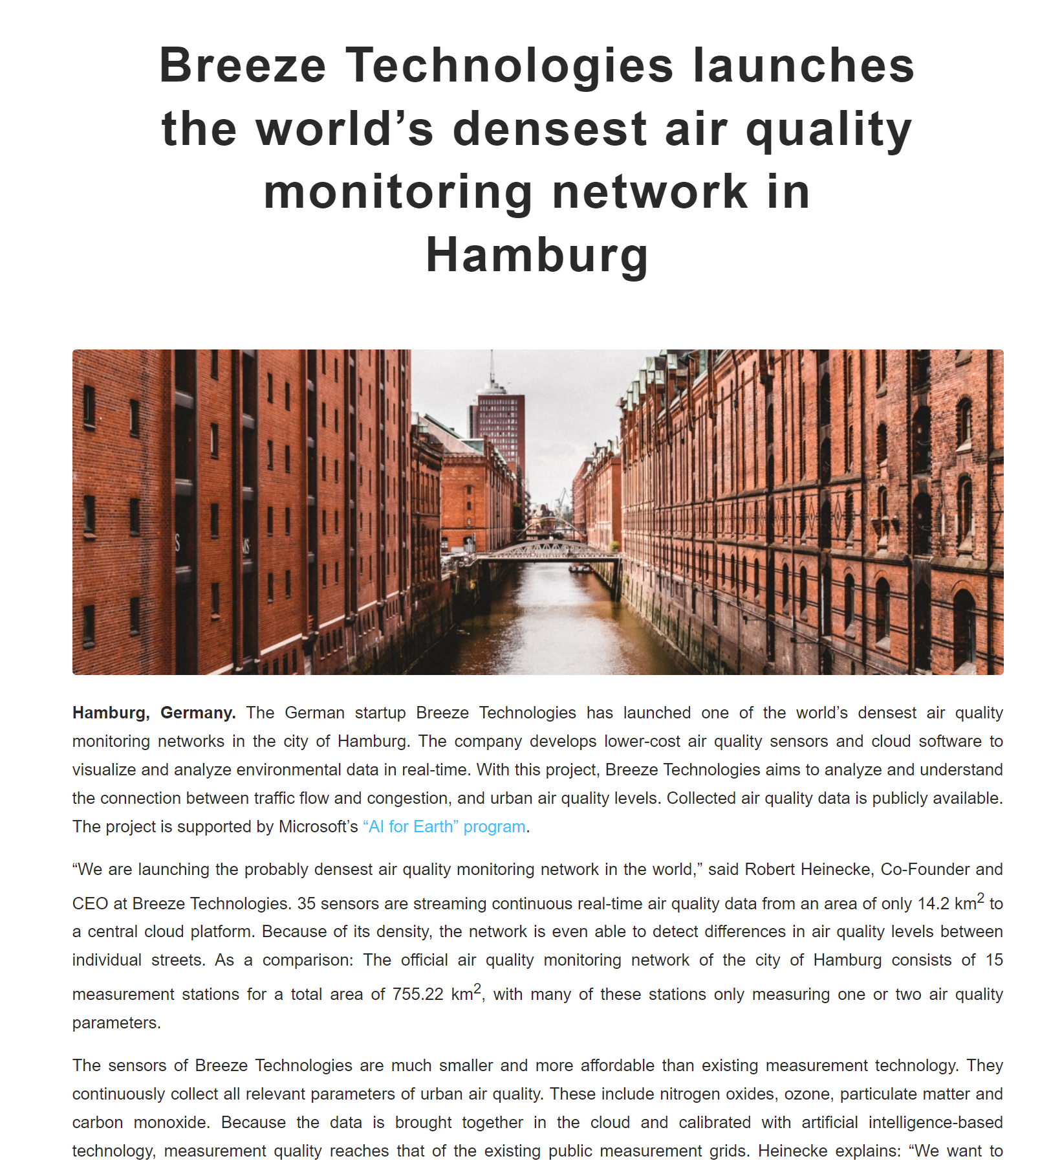

Slide 11
Notes:
1900 Easter Parade

Slide 12
Notes:
1913 Easter Parade

Slide 13
